Slide 1

Marketing Management Presentation
Under the guidance of
Dr. Kuldeep Baishya
Submitted by
Group - 4
School
of
Business
Indian Institute of Technology
Guwahati
Roll Number | Name
234024013 | Muskaan Chaddha
234024014 | Pragati Kumari
234024015 | Prakrut Shetalbhai Desai
234024016 | Rahul Kumar

Slide 2
The Choice
Reliance (RIL)
(Conglomerate)
Reliance Retail
(Strategic Business Unit [i.e. SBU])
AJIO
(Product)

Slide 3
Marketing Management Philosophy : Customer Centricity
Reliance detastes the “Myopic Management Philosophy”.
Adaptability : Reliance is highly adaptable to shifting paradigm.
Via 1) Product Diversification, 2) New Product Development and 3) New SBU Development

Slide 4
Analysis of the Marketing Environment
SWOT Analysis : Strength, Weakness, Opportunity, Threats
PESTEL Analysis : Political, Economic, Socio-cultural, Technological, Environmental, Legal
5 C’s Analysis : Company, Customers, Collaborators, Competitors, Context

Slide 5
SWOT ANALYSIS
Strengths (Internal):
Strong financial backing from Reliance, enabling investment in technology and infrastructure.
Diverse product offerings in fashion and lifestyle.
Robust supply chain management.
Weaknesses (Internal):
Strong competition in the online fashion market.
Dependence on digital infrastructure, susceptible to cyber threats

Slide 6
Opportunities (External):
Growing e-commerce market in India.
Expansion of Ajio's private label brands.
Increasing digital adoption and e-payment systems.
Threats (External):
Intense competition from established e-commerce giants like Amazon and Flipkart.
Fluctuations in consumer preferences.
Regulatory changes in the e-commerce sector.

Slide 7
PESTEL Analysis:
Political:
Government policies and regulations affecting e-commerce.
Taxation policies.
Economic:
Economic conditions affecting consumer spending.
Exchange rates impacting import costs.
Sociocultural:
Evolving consumer trends and preferences.
Cultural factors influencing fashion choices.

Slide 8
Technological:
Advancements in e-commerce technology.
Potential for AI-driven personalization.
Environmental:
Sustainability concerns impacting fashion choices.
Pressure for eco-friendly packaging and logistics.
Legal:
Compliance with data privacy laws.
Intellectual property and trademark issues.

Slide 9
5C Analysis
Company: Reliance has a strong presence and financial backing.
Customers: Targeting a diverse customer base interested in fashion and lifestyle products.
Collaborators: Collaborations with brands and logistics partners are crucial.
Competitors: Facing competition from Amazon, Flipkart, and other e-commerce players.
Context: Operating in the dynamic Indian e-commerce market with changing consumer behaviors.

Slide 10
Consumer Feedback
Triggers of purchase :
1. Product Quality and Variety, 2. Discounts and Promotions, 3. Return and Exchange Policies, 4. Payment Options, 5. Shipping and Delivery Time
Stages in the purchase :
1. Recognition of Need or Desire, 2. Information Gathering, 3. Evaluation and Comparison, 4. Adding to Cart, 5. Payment Selection, 6. Order Confirmation, 7. Shipping and Delivery, 8. Returns and Exchanges (if necessary), 9. Post-Purchase Experience, 10. Repeat Purchase and Loyalty
Inputs sought :
Details of Inputs sought after each stage
Roles played :
How 1) Ajio, 2) Consumers and 3) Marketers synergised for optimal market functioning
Time taken : *self explanatory

Slide 11
Analysis of the Marketing Environment after Consumer Feedback
RE-ASSESSMENT OF STRATEGY
Segmentation : Age, Gender and Psychographic
Targeting : Fast fashion and Quality Product
Positioning : Symbolic, Functional and Experiential

Slide 12
Product Mix and Product Line Analysis
.
APPAREL | FOOTWEAR | ACCESSORIES | BEAUTY & PERSONAL CARE | ELECTRONICS
T-Shirts | Sneakers | Handbags | Cosmetics | Mobiles
Shirts | Sandals | Jewellery | Eye Shadows | Smart Watches
Jeans | Flats | Hats | Lipsticks | Speakers
Winter Wear | Heels | Belts | Eyeliner | Cameras
Ethnic Wear | Boots | Scarves | Skin Care | Wearables
Sports & activewear | Formal Shoes | Furniture | Hair Care | Chargers

Slide 13
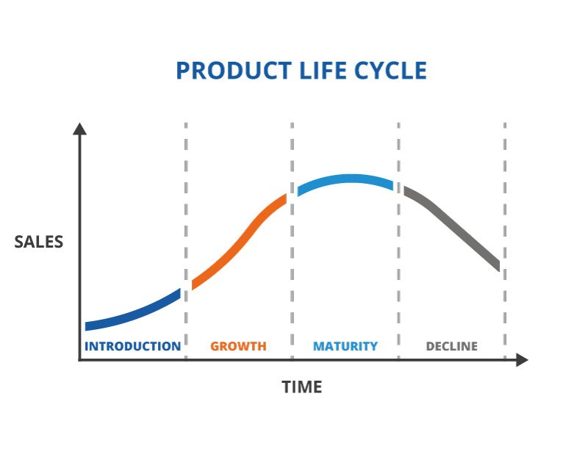
Project Life Cycle
The Growth Phase

Slide 14
Detailed action plan to revive Ajio
1. Conduct Market Research:
• Analyse sales data, online traffic, and customer feedback to identify areas that need improvement.
2. Specialise and Niche Down:
• Niche specialisation can help the product stand out in a crowded market and attract a dedicated customer base.
3. Leverage Social Media:
• Create engaging content that showcases the product's unique features and benefits.
4. Collaborate with Influencers:
• Identify influencers in your niche who have a genuine following that aligns with the target audience.

